Slide 1
Developing DIY Drone Platform. Working with GitHub.

Slide 2
FFirst of All we should to finish a team group.
1) Dayo
2) Flami
3) Jaan
4) TJ ?

Slide 3
Second Task is a understand our project name.
My Idea is Electrics Eagles Open Source Arduino based Drone Development platform . Shortly EEOSABDDP.

Slide 4
Also We need to made short and remembered name for (DDP)*
*Drone development Platform.

Slide 5
After I we should to plan our project.
Read Rules
Start Answer Questions. (Maybee Jaan)

Slide 6
We need to think about our Software / Hardware Products names.

Slide 7
Ask yourself are you ready to hard work?

Slide 8
We should decide so what who do.
Hardware Planning Everybody.
Making Library from our code Mike
Write Normal Sublime Text 3 & VS Code Plugins Danio
PC Software ( Setup Wizard , first check status designer … ) Alex
Writing report ( Somebody else ( Jaan)).
Make tutorials (Everybody)

Slide 9
What we had now.
1) Bad working Sublime Text 3 Plugin
2) Drone Core Firmware
3) Flying hardware.
4) Some references.
We should:
Make Hardware easyer
Rewrite Sublime Text Plugin
Write PC Tool
Write Report
Make tutorials.
Pack Core Firmware as Library

Slide 10
Programming Lanuages
Sublime Text 3 & Vs Code Plugin (Python + CSS+ Pyside2)
PC Tool is a Java
Drone Core is a C++ / C / asm

Slide 11
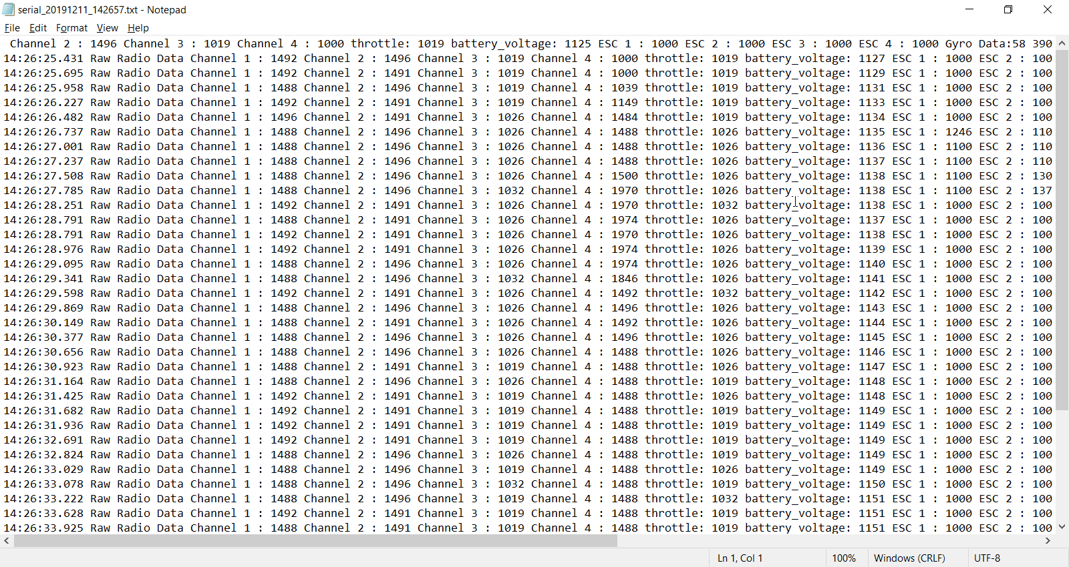
Anyway we need normal log system.

Slide 12
We need add to drone power supply and out telemetry system.
Our needed voltages.
+3.3V
+5V
+12V
And a safety diode and fuse.
(You can found one example pcb and schematics in GitHub folder).

Slide 13
Working with GitHub.

Slide 14
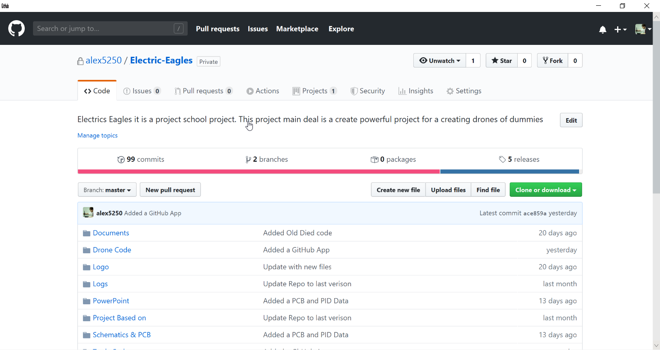
How Work With GitHub.

Slide 15
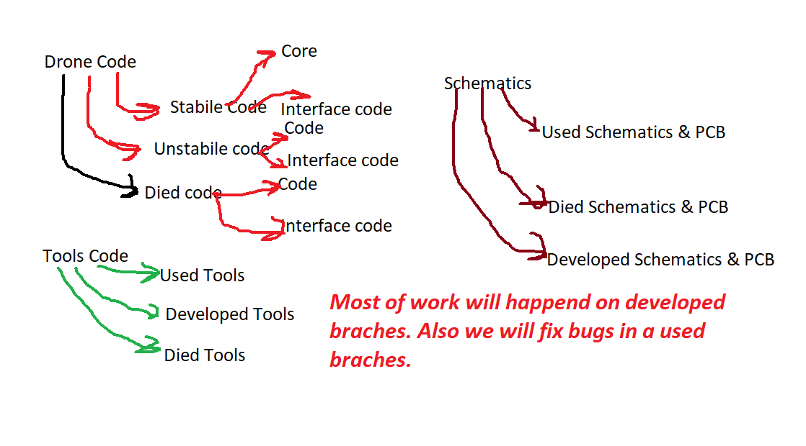
Anyway our GitHub is a large difficult system. It has a chart witch helps found what you need.

Slide 16
Working with GitHub.
First of all you should register on it. After it send your nickname to me I will add you to our repo.
Main Idea of it that everybody can edit code, add resources ,fix bugs, add tasks. So I don`t do everything.

Slide 17
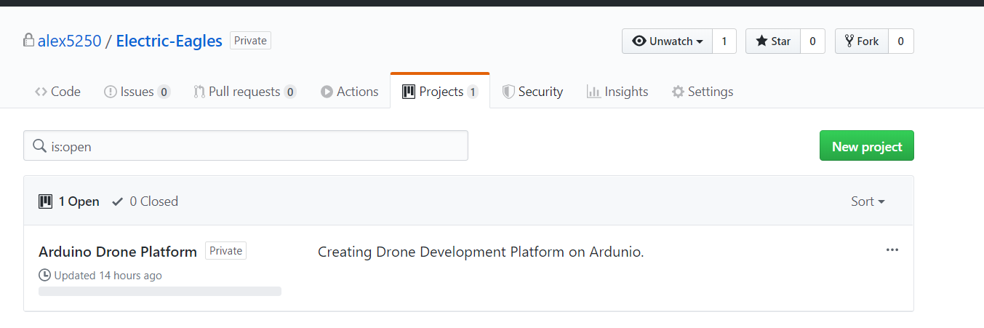
We had a some interesting parts of GitHub Repo. It is a project.

Slide 18
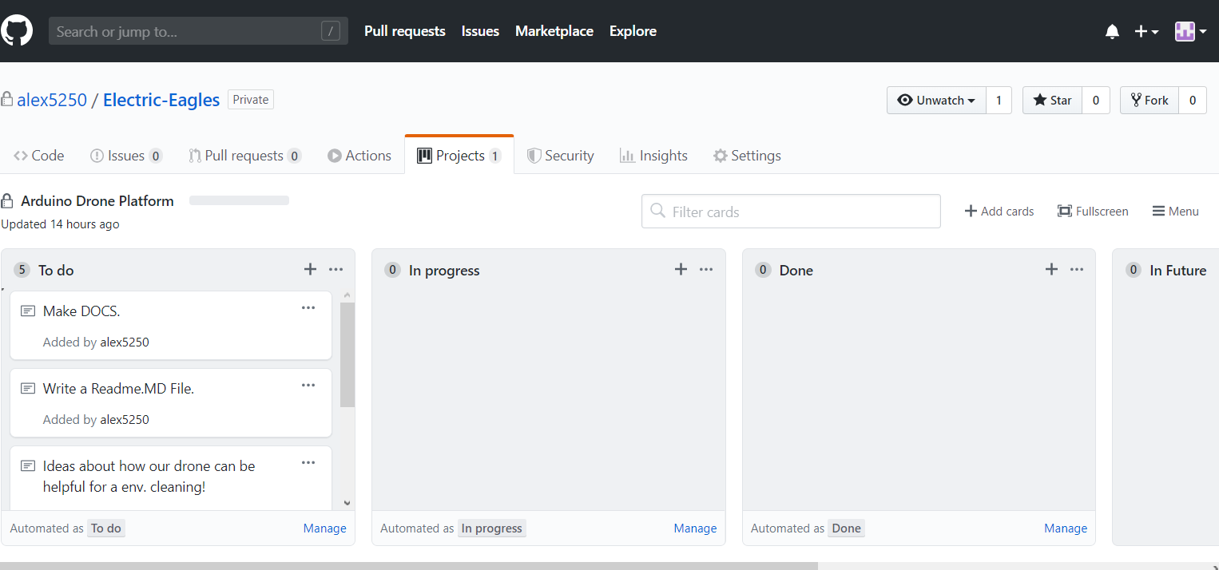
Here is written all tasks that we do. You can take it move it to progress and write your name. If you done task move it to done.
Alex
Alex

Slide 19
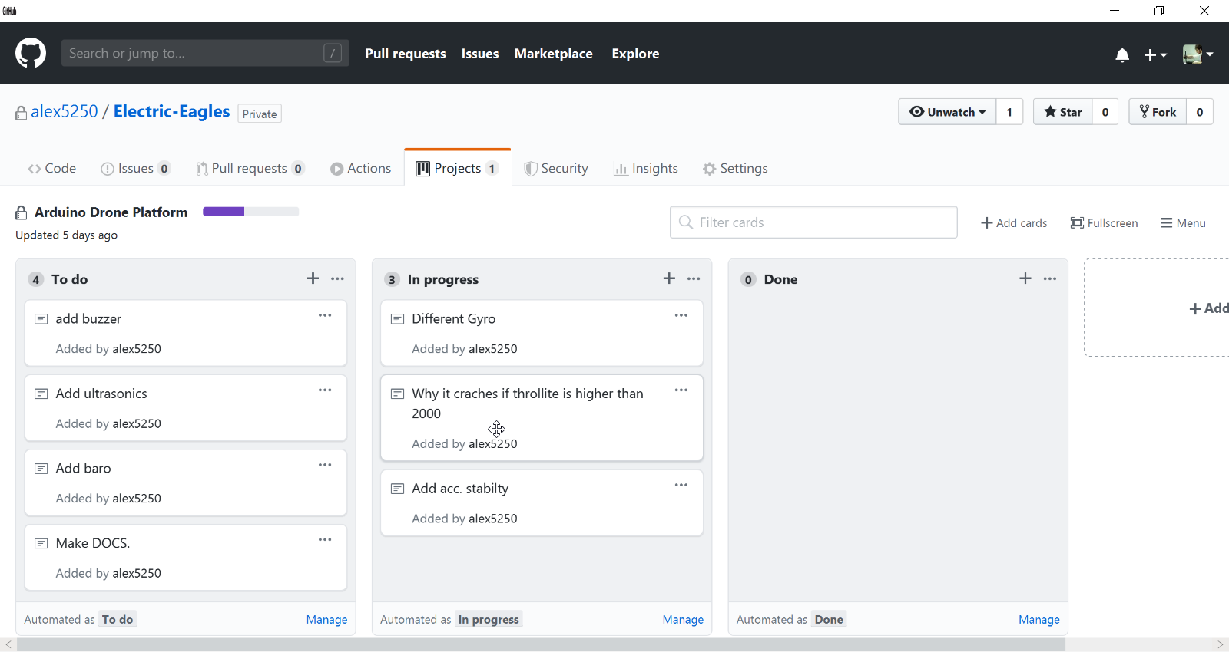

Slide 20
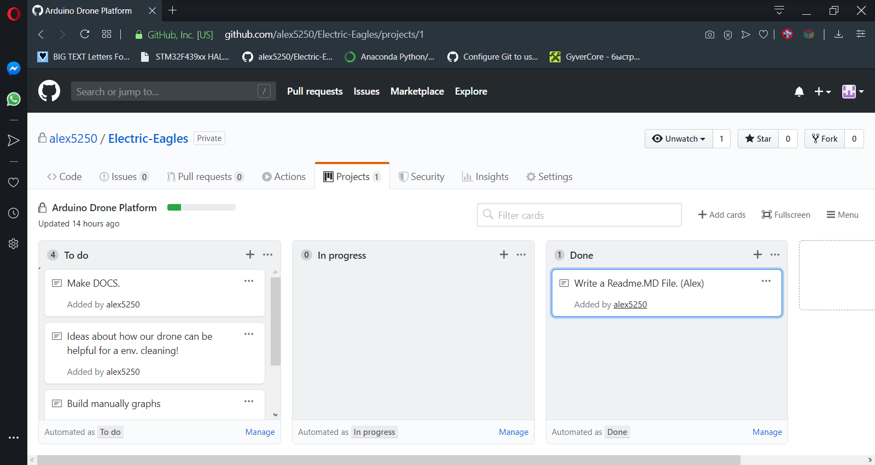

Slide 21
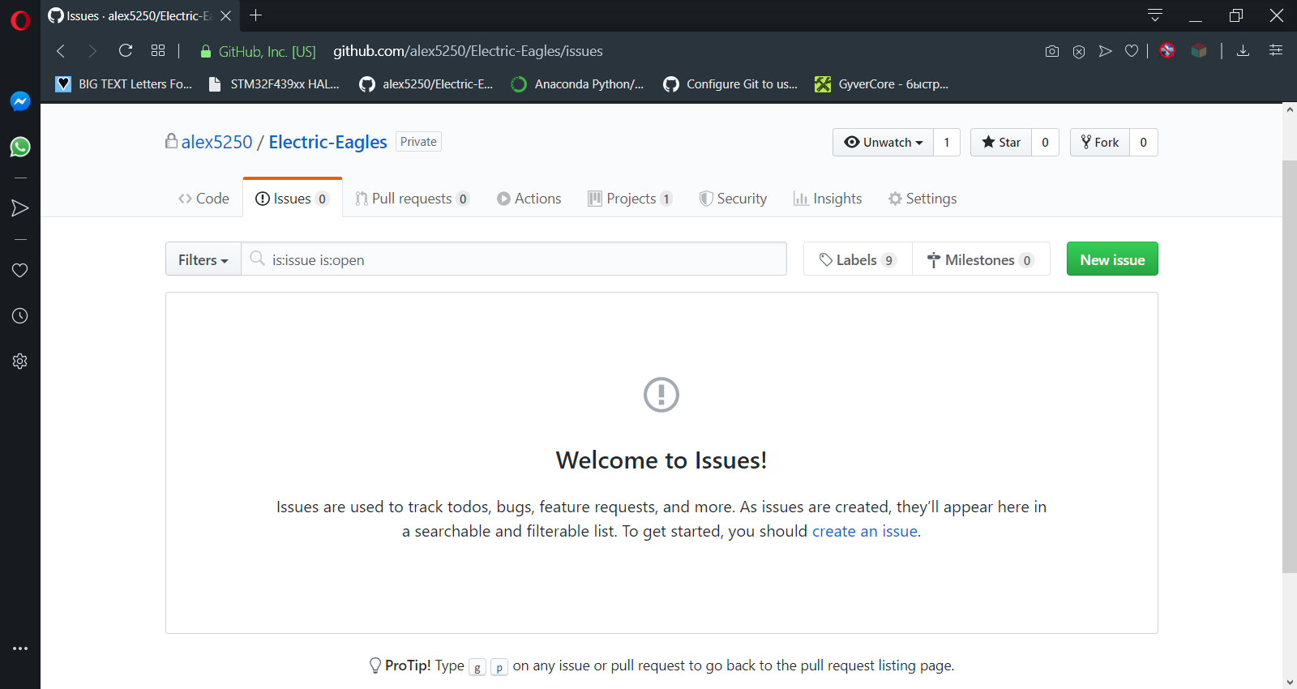
If you found a bug in code & hardware. Make report in Issue page. Explain it mostly understandable that you can.

Slide 22
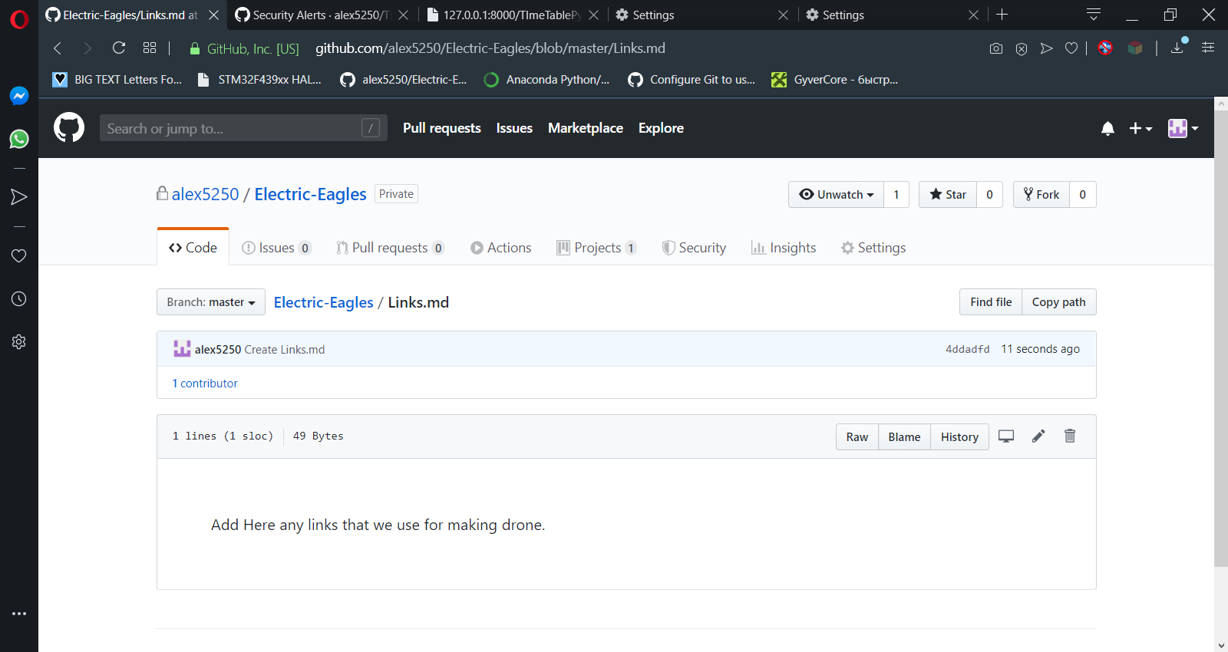
All links goes here.

Slide 23
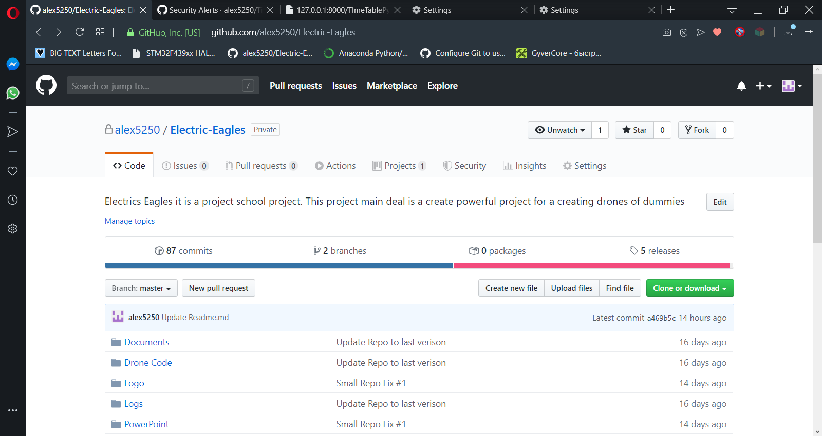
Any actual software you can found it releases branch.

Slide 24
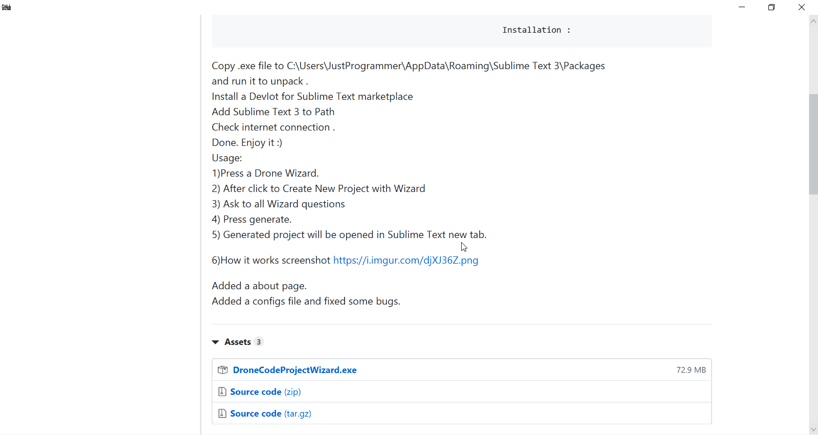

Slide 25
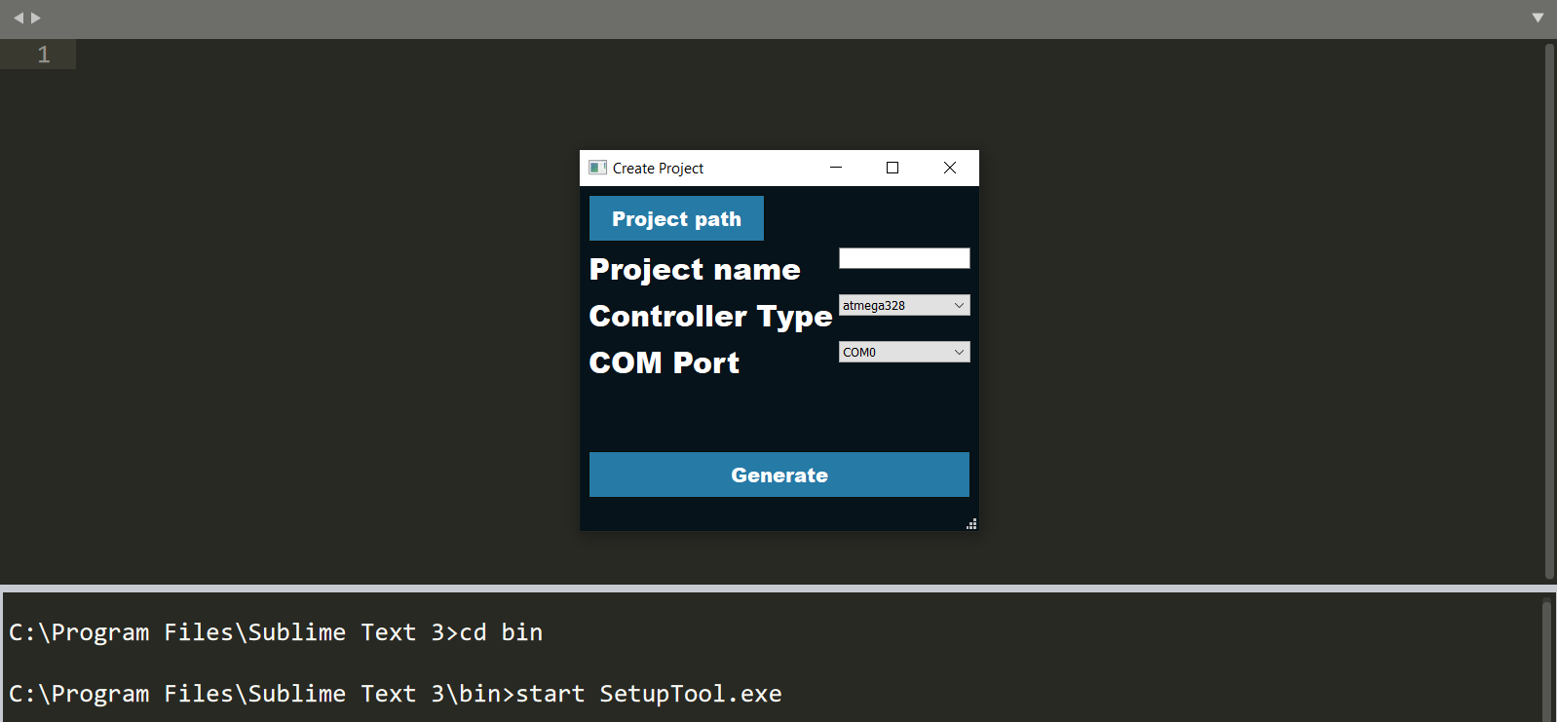

Slide 26
